Slide 1


Exploratory
Data Analysis and Visualization of
Face Masks Data

Slide 2




Group 4 - Team Details
Dibyendu Laha
Sumistha Saha
Samandeep Singh Tomar
21f1006498@ds.study.iitm.ac.in
21f1000276@ds.study.iitm.ac.in
21f1001112@ds.study.iitm.ac.in

Slide 3




Technologies Used
Python
Excel
NLP - Spacy, NLTK
Google Colab
Flourish Studio
Numpy, Pandas

Slide 4
Most Popular Face Masks & their Key-Features
Objective
To identify the top-selling face masks in terms of consumer preference and demand, and to analyze their features that make them popular among buyers. This information can be used to guide purchasing decisions, to identify trends in the market, and to understand the factors that contribute to the success of certain face masks over others.

Slide 5
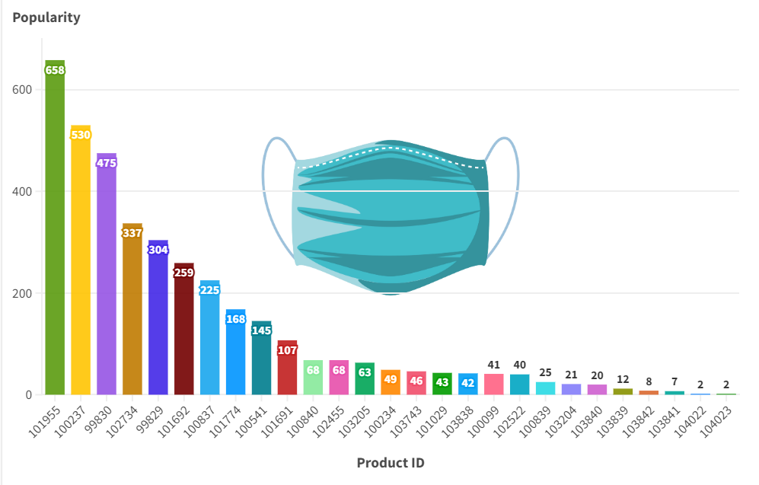
The Most Popular Face Mask (Link to visualization)
The most popular face mask according to our analysis is
“SunJoy, KN95, Professional Protective Disposable Face Mask, 10 Pack”
It has more than 600 reviews.
The main features of this mask are -
Tight fit
Polluted air proof,
Adjustable nose clip,
Made for any face types.
Made of - Non-woven fabric, melted woven fabric and cotton

Slide 6
Features and materials of top 5 popular masks :
Features / Qualities
PP non-woven fabrics.
PP meltblown woven fabrics.
PP hot cotton.
Soft cotton material.
100% Cotton.
polyester
meltdown fabric, 70% non-woven fabric.
Tight fit, polluted air proof
Adjustable nose clip
One size fits most
Washable, reusable
Easy to wear, Comfortable
Chin Guard
Effectively Block Droplets, Catkins, Dust and Pollen
Good Air Permeability
Soft mesh pattern that causes no irritation against the skin.
MATERIAL

Slide 7
Analysis and Insights from Text Reviews
Dataset: 'reviews.tsv' containing product reviews, ratings, and language information
See the full notebook at https://colab.research.google.com/drive/1MC3bcP9hcaENCYWYOgZ-sNMn_SPLHFfb?usp=sharing
Objective: Analyze the reviews of the most popular face masks and identify top reasons why consumers like them

Slide 8
Technical Appendix
Tokenization: Used NLTK's word_tokenize to split text into individual words
Stopwords Removal: Removed common English stopwords and mask-related words using the NLTK stopwords corpus
Word Frequency Counting: Utilized the Counter class from the collections module to count word occurrences
Word Cloud Generation: Generated a word cloud using the WordCloud package with a mask image for shaping
TF-IDF Vectorization: Converted text into numerical vectors using TfidfVectorizer from sklearn.feature_extraction.text
Cosine Similarity: Calculated similarity between word and sentences vectors to find relevant example sentences

Slide 9
Data Preparation
Loading and processing the TSV file using pandas
Calculating average ratings and total sales for each product
Merging data and computing popularity scores
data = pd.read_csv('reviews.tsv', sep='\t')
average_ratings = data.groupby('productId')['ratingValue'].mean().reset_index(name='average_rating')
total_sales = data.groupby('productId').size().reset_index(name='total_sales')
product_data = average_ratings.merge(total_sales, on='productId')
product_data['popularity_score'] = product_data['average_rating'] * product_data['total_sales']

Slide 10
Tokenization and Stopwords Removal
Tokenizing review text using NLTK's word_tokenize
Removing stopwords using the NLTK stopwords corpus
def tokenize(text):
tokens = nltk.word_tokenize(text.lower())
return [word for word in tokens if word.isalnum()]
most_popular_product_reviews['tokens'] = most_popular_product_reviews['reviewText'].apply(tokenize)
filtered_tokens = [word for word in all_tokens if word not in stop_words]

Slide 11
Top Reasons
Counting word frequencies using the Counter class from the collections module
Displaying top 10 reasons why consumers like the most popular face masks
word_frequencies = Counter(filtered_tokens)
top_reasons = word_frequencies.most_common(10)

Slide 12
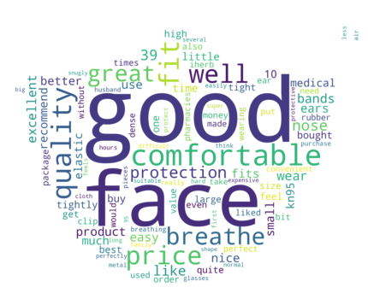
Word Cloud
Generating and displaying a word cloud using the WordCloud package
Using a mask image for shaping the word cloud
generate_wordcloud(word_frequencies, "Top Reasons", "mask.png")

Slide 13
Example Sentences
Finding and displaying example sentences for each top reason
Using cosine similarity and TF-IDF (TfidfVectorizer from sklearn.feature_extraction.text) to find relevant sentences
Presenting the top reasons along with example sentences
def find_sentences_containing_word(word, reviews, num_examples=3):
...
vectorizer = TfidfVectorizer(stop_words='english')
...
similarity_scores = cosine_similarity(word_vector, sentence_vectors).flatten()
...
top_reasons_with_examples = get_example_sentences(top_reasons, most_popular_product_reviews['reviewText'])

Slide 14
Conclusion
Identified top reasons why consumers like them: good, face, comfortable, quality, fit, price, well, breathe, great, and protection
Generated a word cloud to visually represent these reasons
Provided example sentences from reviews for each top reason

Slide 15
For a more detailed view of the analysis, see the full notebook at
https://colab.research.google.com/drive/1MC3bcP9hcaENCYWYOgZ-sNMn_SPLHFfb?usp=sharing

Slide 16
Different profiles of Consumers
Objective
Segmenting consumers based on some factors can help marketers better understand their target audience and create targeted marketing campaigns that speak directly to their needs and preferences.

Slide 17
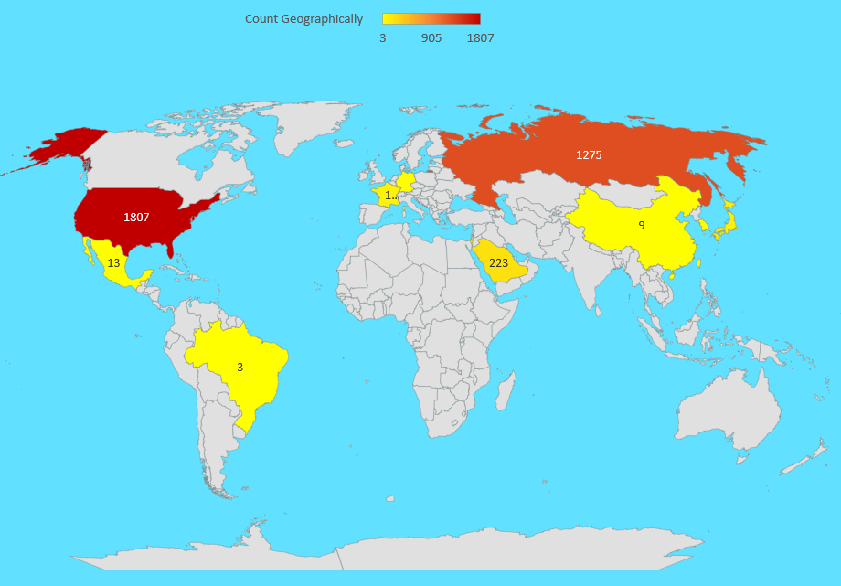
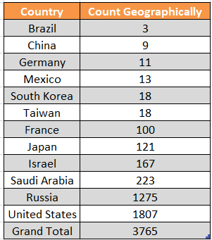
Consumer Demographic Segmentation

Slide 18
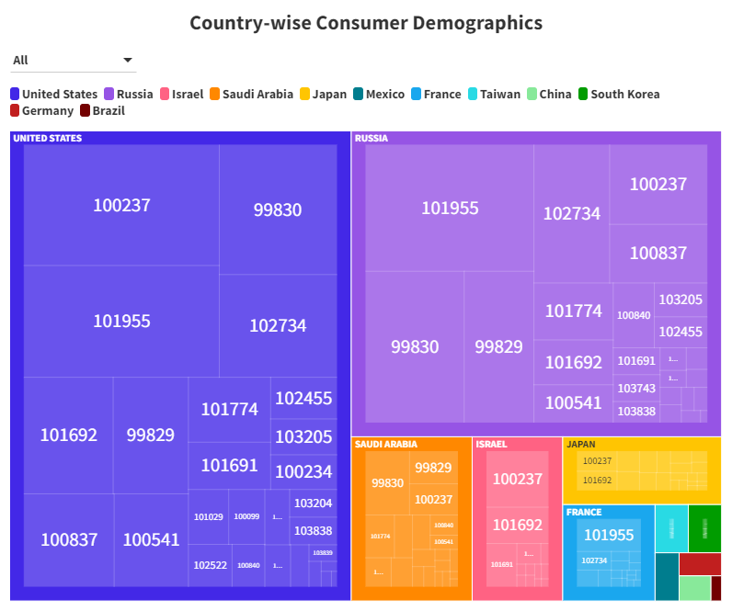
For Full Visualization, Click Here

Slide 19
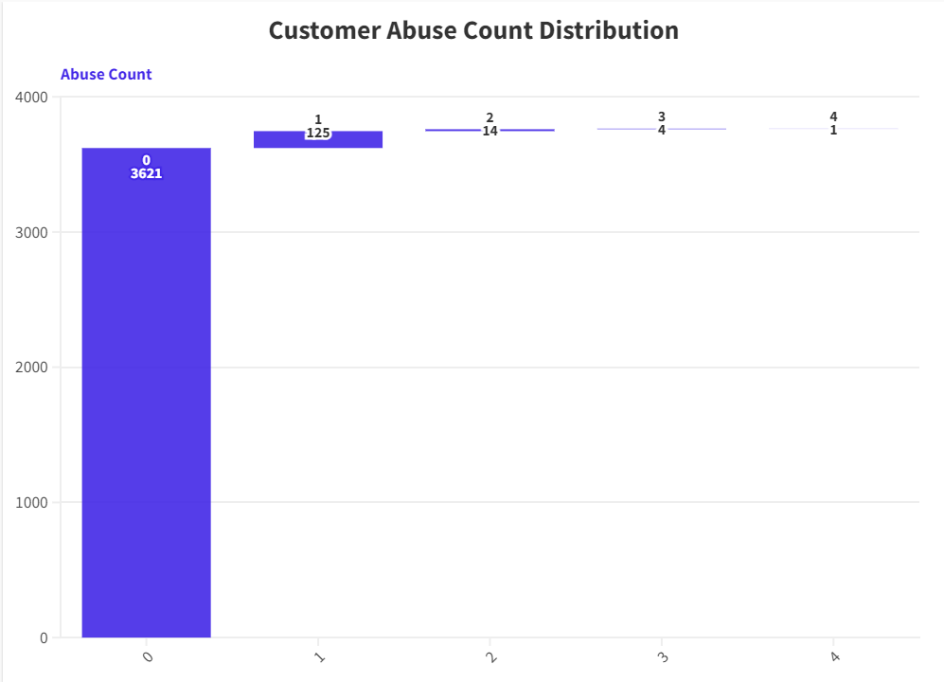
Consumers Behaviours Segmentation
Total Reviews count : 3765
0 Abuse Count : 3621
= (3621/3765) x 100 %
= 96.17 %
1 Abuse Count : 125
= (125/3765) x 100 %
= 3.32 %
2 Abuse Count : 14
= (14/3765) x 100 %
= 0.37 %
3 Abuse Count : 4
= (4/3765) x 100 %
= 0.1 %
4 Abuse Count : 1
= (1/3765) x 100 %
= 0.02 %
For full Visualization, Click Here

Slide 20
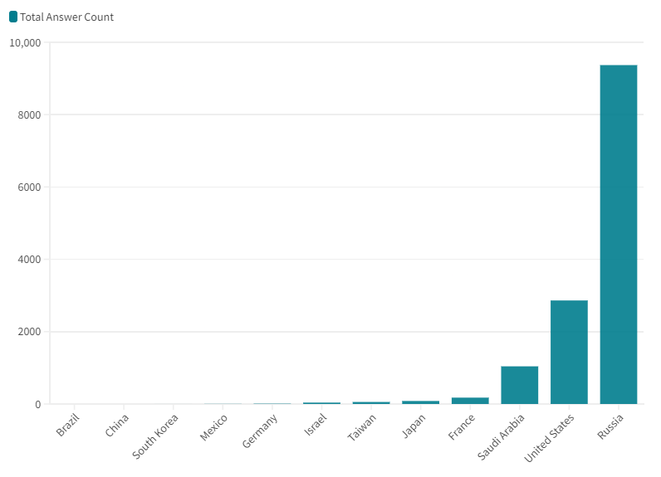
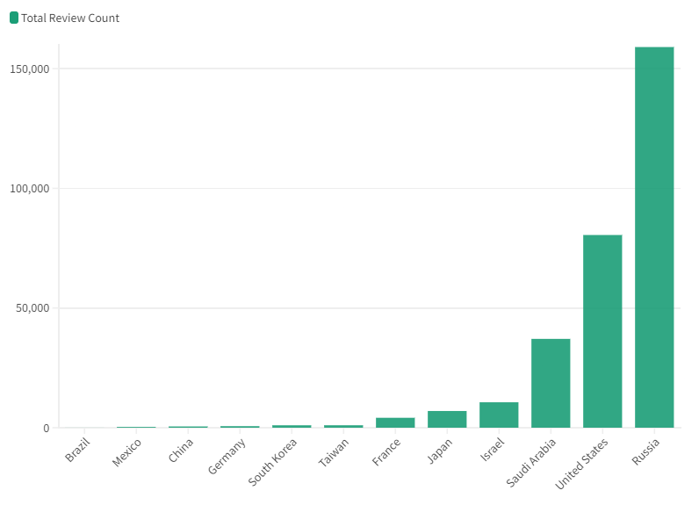
Total Answer Count (Full Visualization Link)
Total Review Count (Full Visualization Link)

Slide 21
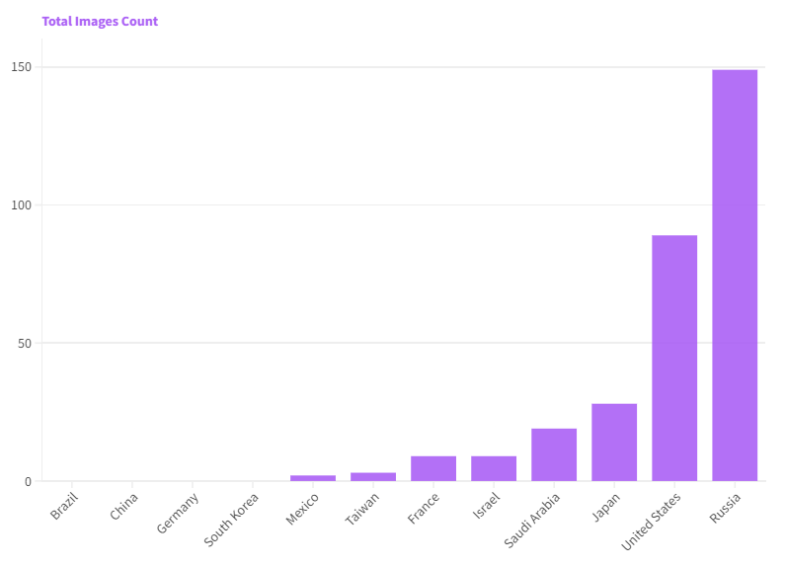
Total Images Count (Full Visualization Link)

Slide 22
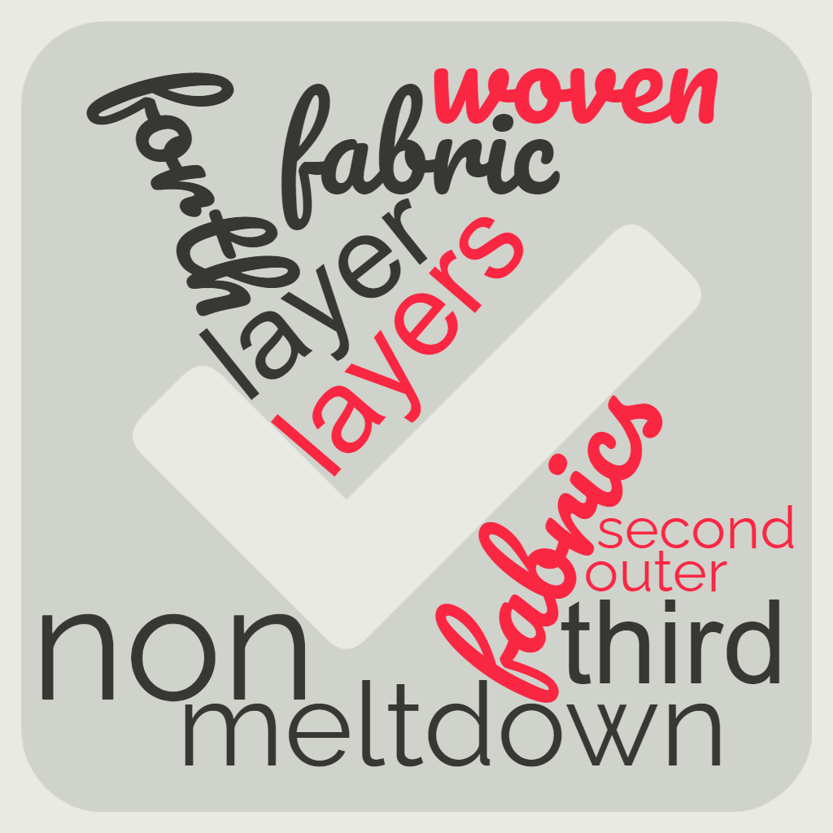
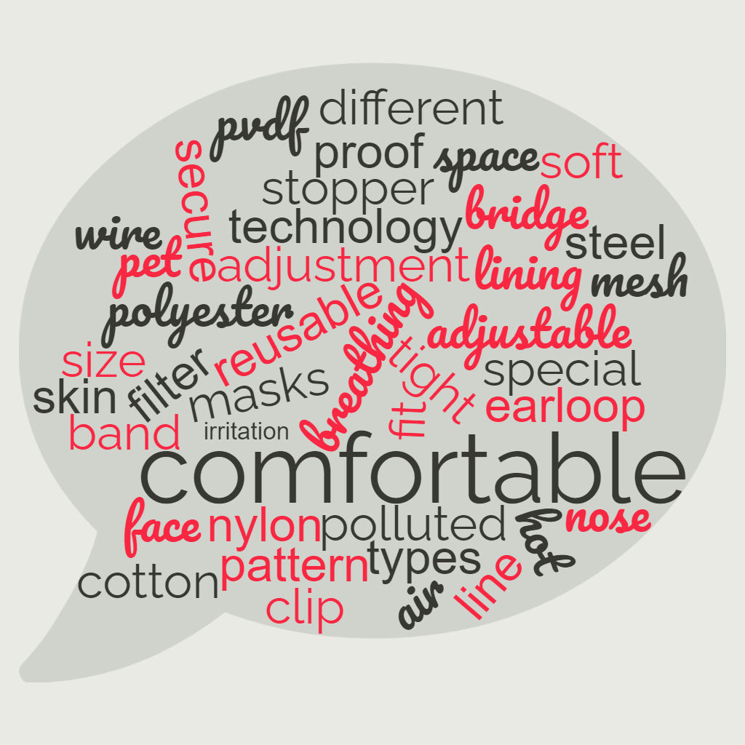
Consumers Preference Segmentation
Materials
Features

Slide 23
For a more detailed view of the analysis, see the full notebook at
https://colab.research.google.com/drive/1e2dzno-yLwWW4wzAFyvWM_YLyoa23zu4?usp=sharing
https://colab.research.google.com/drive/1UaPwI83x3ANgifCB3C0K9duPY1IUqC4o?usp=sharing

Slide 24
Additional Data Sources can be used for more insights
Demographic information about customers: age, gender, location, and occupation
Data on purchasing habits and preferences: repeat purchases, bundle purchases, and preferred brands
Social media activity: comments, likes, and shares related to face masks and personal care products
Survey data from consumers about their preferences, concerns, and expectations from face masks

Slide 25
Key Findings & Implications
Target market segments based on the top reasons why consumers like face masks. Russia and USA tops on that segment.
Enhance marketing messages to highlight the benefits identified in the analysis (e.g., comfort, quality, fit)
Focus on R&D to improve the features most valued by customers, such as comfort, breathability, and protection
Develop promotional strategies and campaigns tailored to the preferences of different consumer groups

Slide 26
Potential Constraints & Improvements
Constraints:
Limited demographic data on consumers
Potential biases in customer reviews
Reviews may not be representative of the entire customer base.
Improvements:
Use additional data sources to supplement the existing datasets
Apply more advanced NLP techniques (e.g., sentiment analysis, topic modeling) to analyze the reviews
Conduct surveys or interviews with customers to validate findings and gather more insights.

Slide 27
Extra Features which could’ve helped
Skin type and sensitivity: Identify if customers with different skin types have distinct preferences for face masks
Face mask usage frequency: Understand how often consumers use face masks and if this affects their preferences
Specific use cases: Determine if consumers purchase face masks for particular situations (e.g., exercise, travel, pollution)
Brand loyalty: Assess the importance of brand loyalty in face mask purchasing decisions and identify the most popular brand.

Slide 28
Summary Report Link
https://docs.google.com/document/d/1lq2NS25xx0Hfav4CCfbuuAH_yoMQWe_Z2C36ClyFk_4/edit?usp=sharing

Slide 29
THANK YOU

